Slide 1
Vertical Feature Slices
Not Layers
Derek Comartin
@codeopinion
codeopinion.com

Slide 2
Context

Slide 4
Tech
Clients & Server

Slide 5
Authorization

Slide 6
Authorization
Data Access

Slide 7
Authorization
Data Access
Validation

Slide 8
Authorization
Data Access
Validation
Business Logic

Slide 9
Too Many Mixed Responsibilities
(aka Turd Pile)
Authorization
Data Access
Validation
Business Logic
Notes:
TIME: 8

Slide 10
Layer All The Things
Database
ASP.NET
Auth
BLL
DAL

Slide 11
Layer All The Things
BLL
DAL
Database
ASP.NET
Auth
Notes:
Show all the things inside of MVC

Slide 12
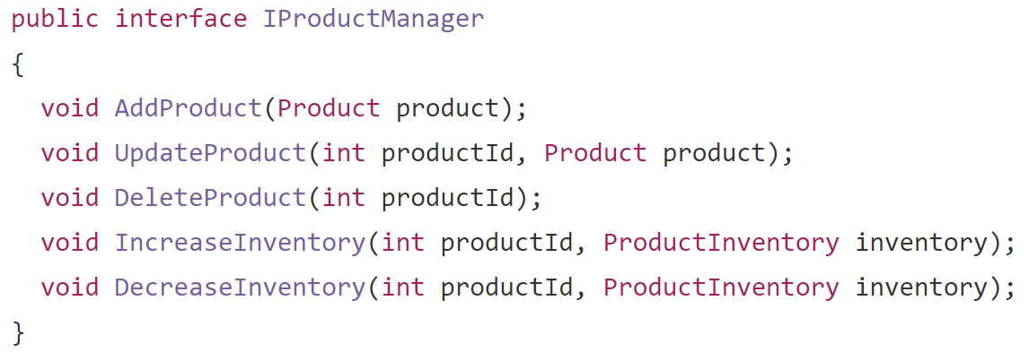

Slide 13
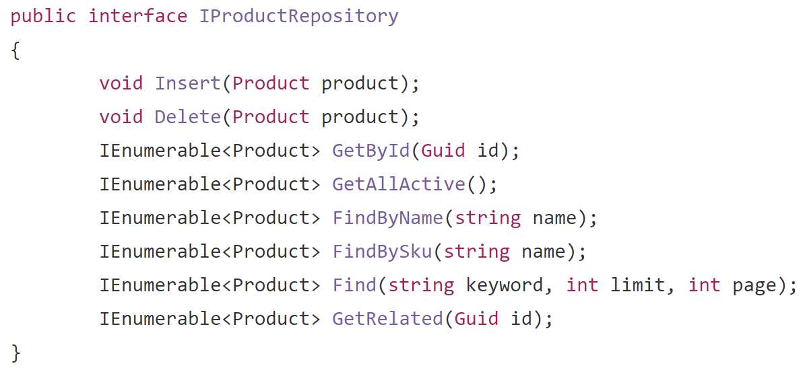

Slide 14
Server
HTTP Only
Clients
ASP.NET
Database
Clients
Clients
Clients

Slide 15
Scheduled / Reoccurring
Non HTTP Requests

Slide 16
Minimize Coupling to a Framework

Slide 17
Common Interface to Invoke Functionality

Slide 18
Layered
Technical Concerns
Why organize by technical concerns?

Slide 19
Simple Changes
Layered
DAL/ProductModel.cs
DAL/ProductRepository.cs
BLL/ProductManager.cs
MVC/Controllers/ProductController.cs
MVC/Views/Products/View.cshtml

Slide 20
Layered
MVC
Auth
BLL
DAL
Database
Notes:
Time: 17

Slide 21
Request-Response
Controller
Uniform API
Database

Slide 22
CQRS
Controller
Request
Database
Auth
BLL
DAL
Notes:
Should be at 22 minutes

Slide 23
Mediator Pattern
Define an object that encapsulates how a set of objects interact

Slide 24
Mediator Pattern
Object A
Object B

Slide 25
Mediator Pattern
Object A
Mediator
Object B

Slide 26
MediatR
https://github.com/jbogard/MediatR

Slide 27
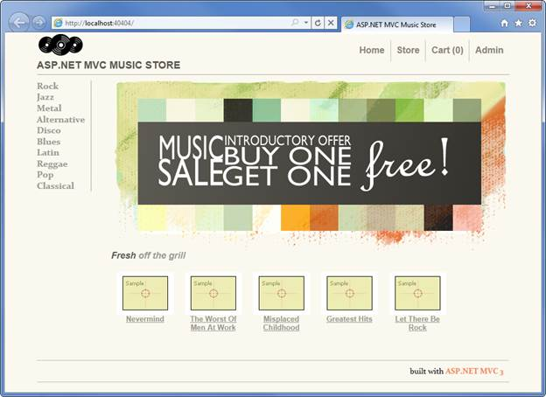
Notes:
Should be at 23 minutes

Slide 28
Mediator Pattern
Request encapsulates all information required to perform action

Slide 29
MediatR
ASP.NET
MediatR
Handler
Request
Request

Slide 30
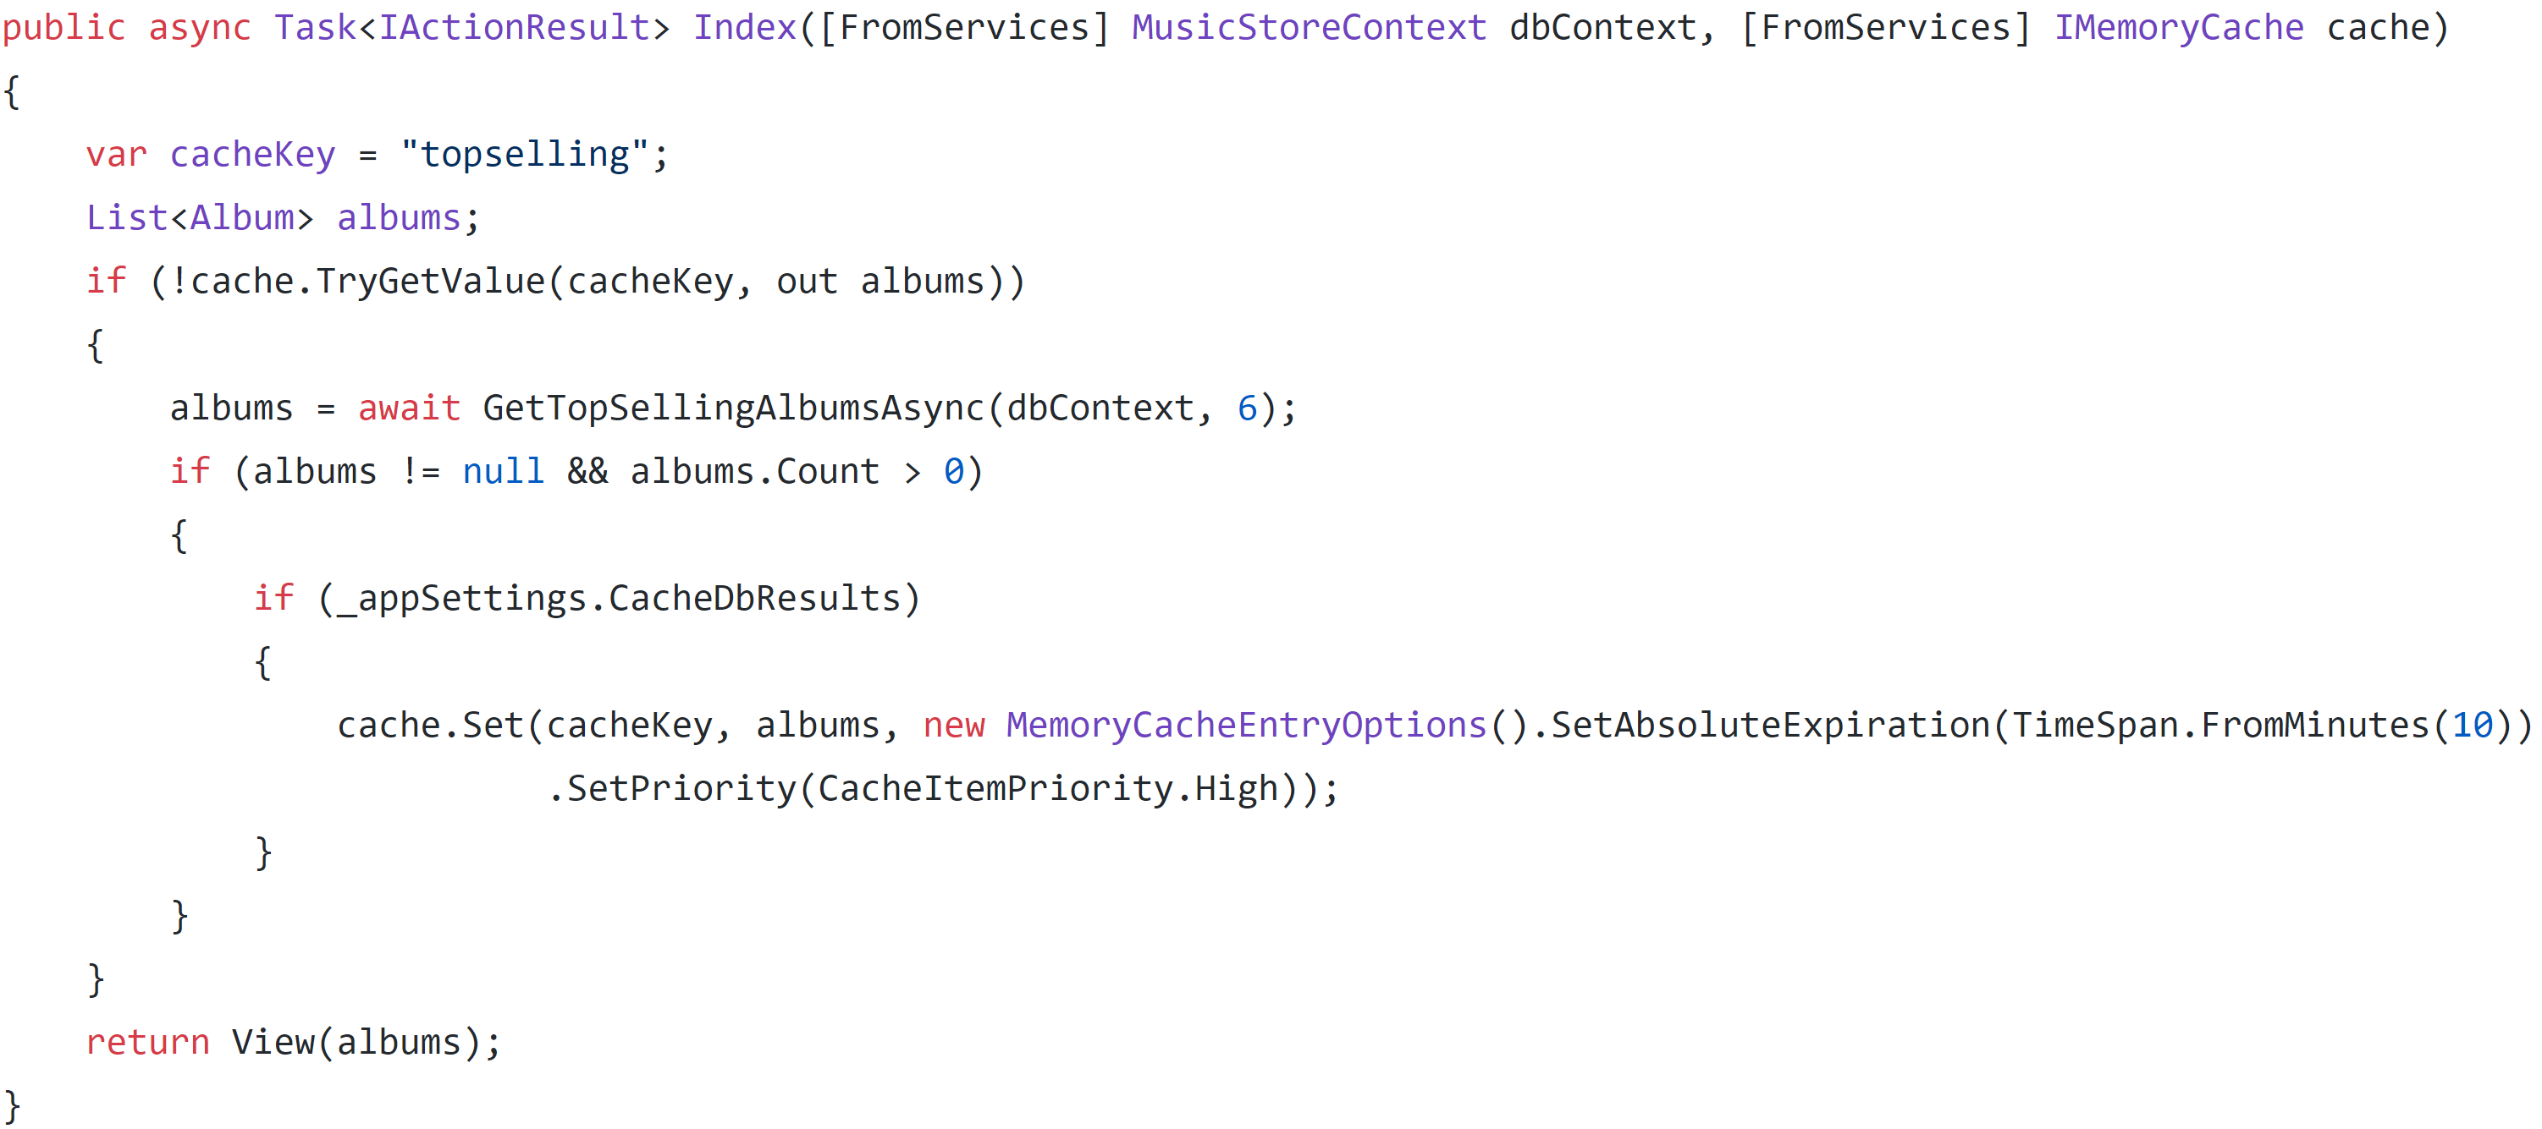
Notes:
Time: 26

Slide 31
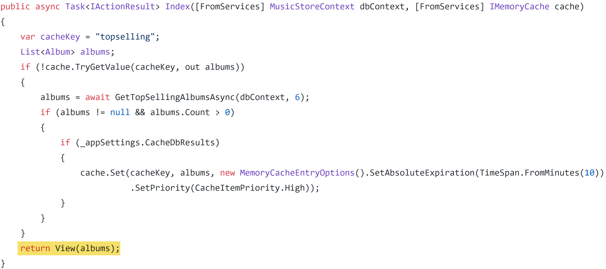

Slide 32
MediatR Request
Caller
MediatR
Handler
Request

Slide 33
MediatR Request

Slide 34
MediatR Request Handler
Caller
MediatR
Handler
Request

Slide 35
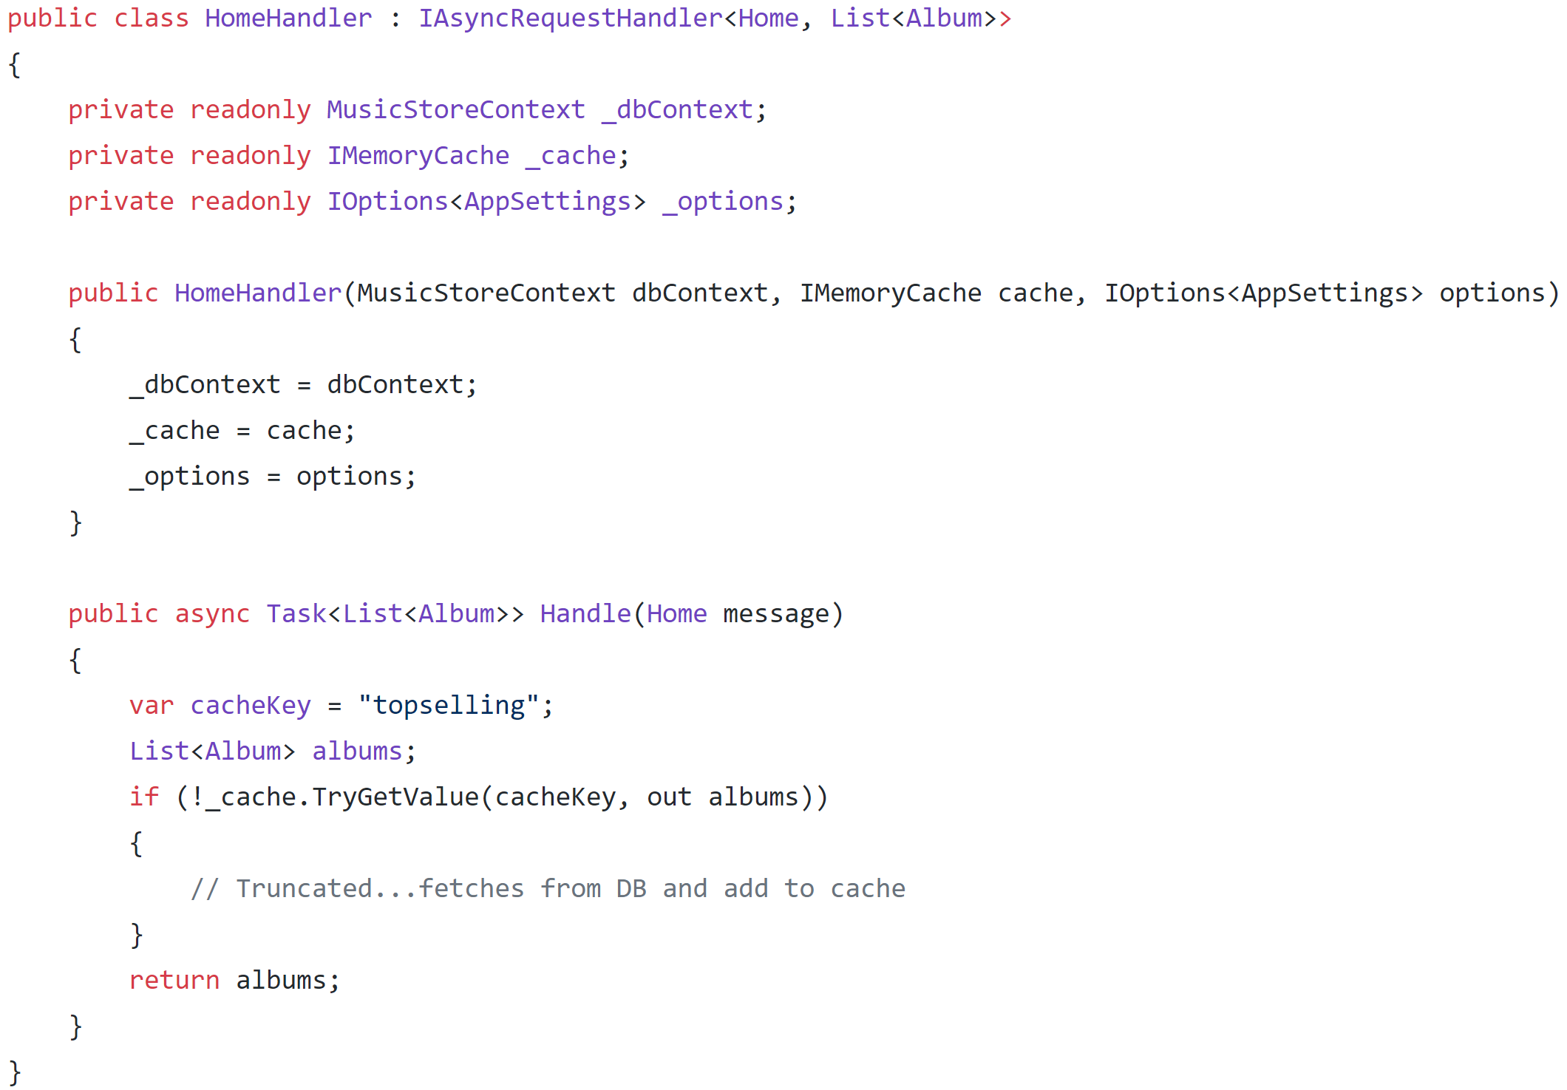

Slide 37
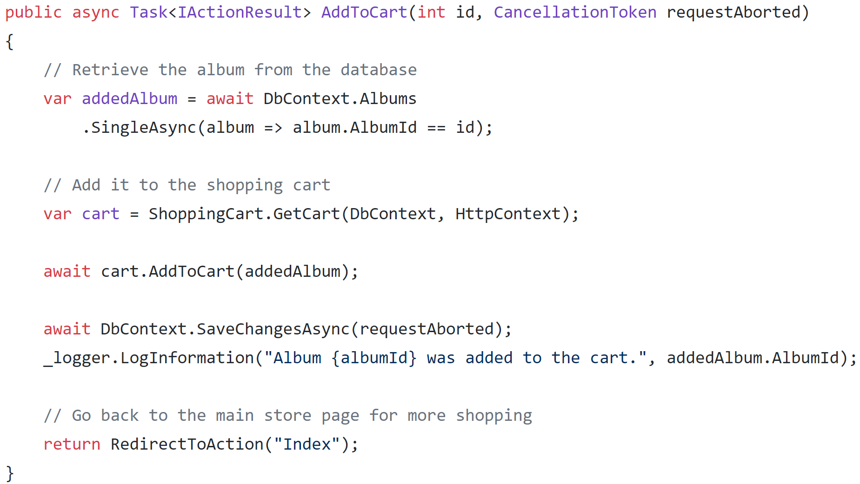

Slide 38
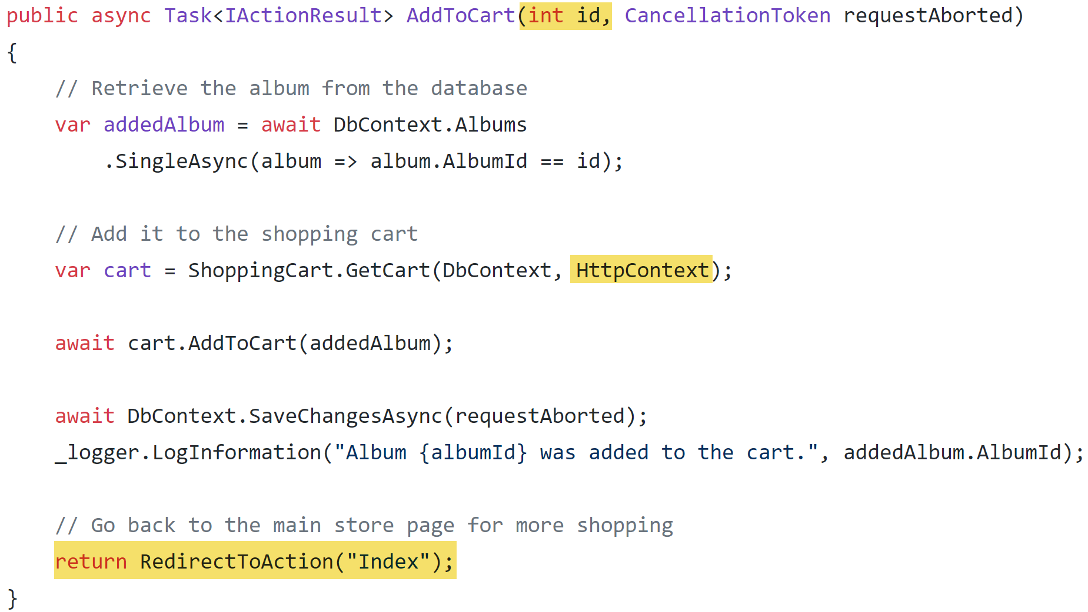

Slide 39
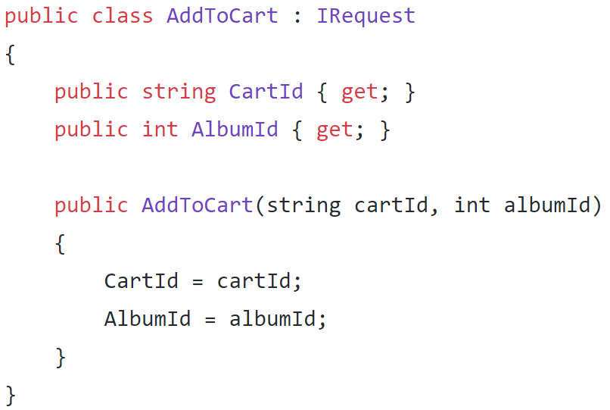
Notes:
Time: 34

Slide 40
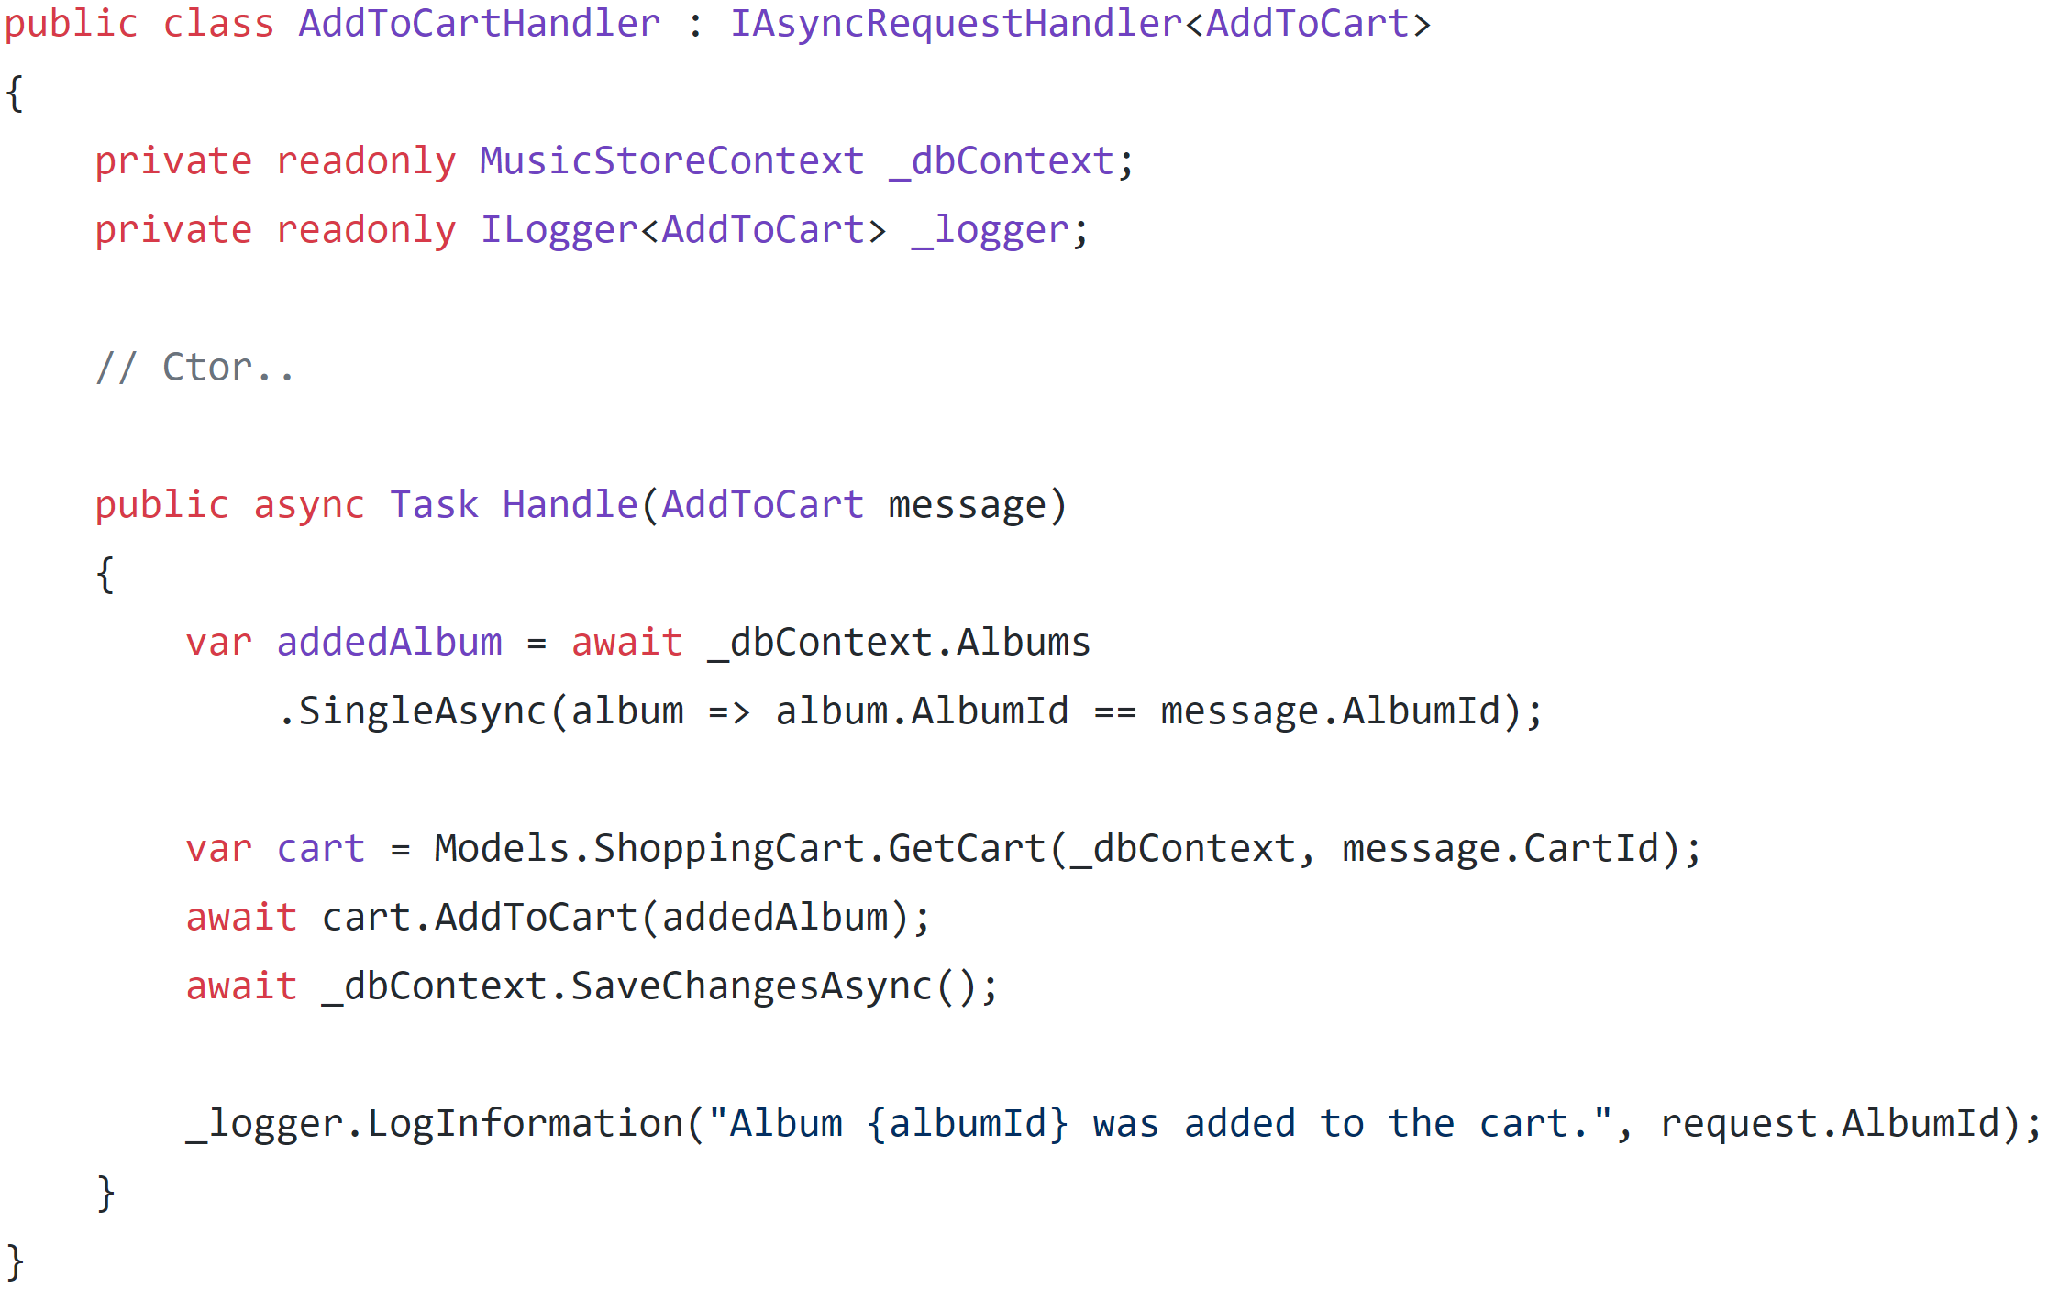

Slide 42
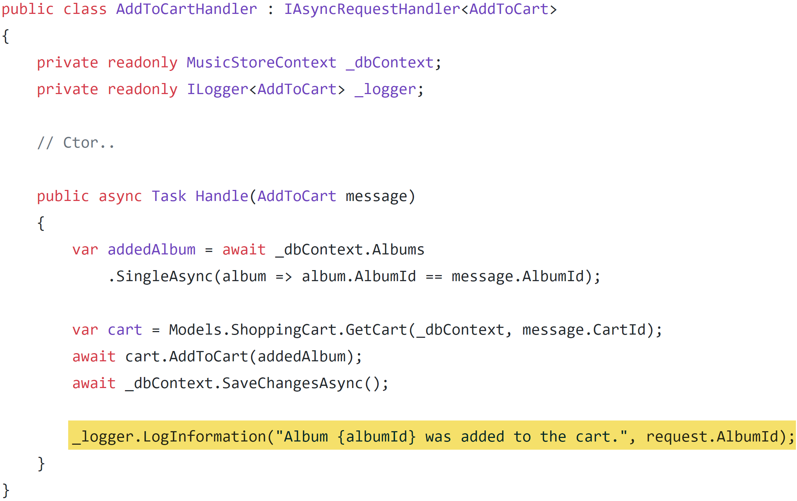

Slide 43
MediatR Behaviors
Caller
Request Pipelines
Request
MediatR
Pre Process Handler
Handler
Post Process Handler

Slide 44
MediatR Behaviors
ASP.NET Core MVC
Request Pipelines
Request
MediatR
Handler
Add to Cart Logger

Slide 45
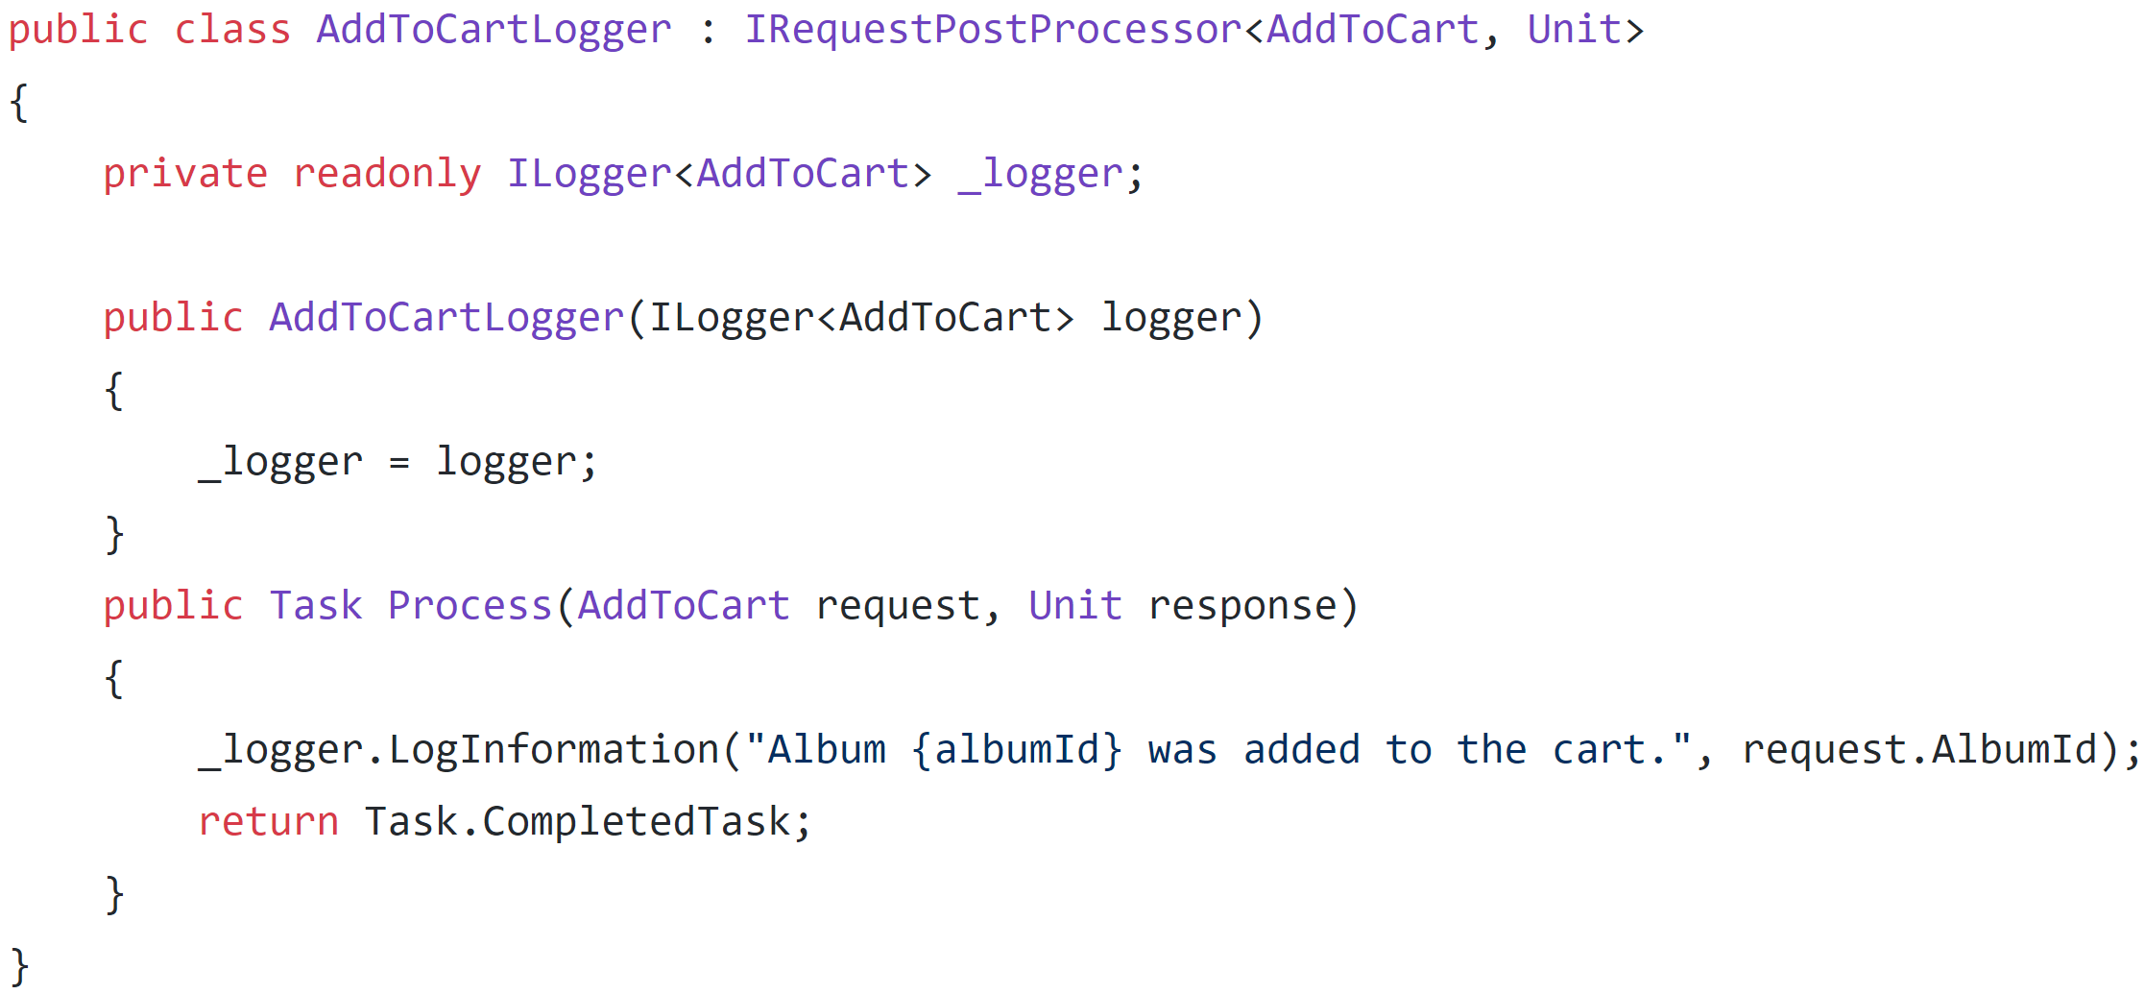

Slide 46
Handler
MediatR Notifications
Publish + Subscribe
Caller
MediatR
Handler
Notification
Handler
Notes:
TODO: Add Diagrams

Slide 47
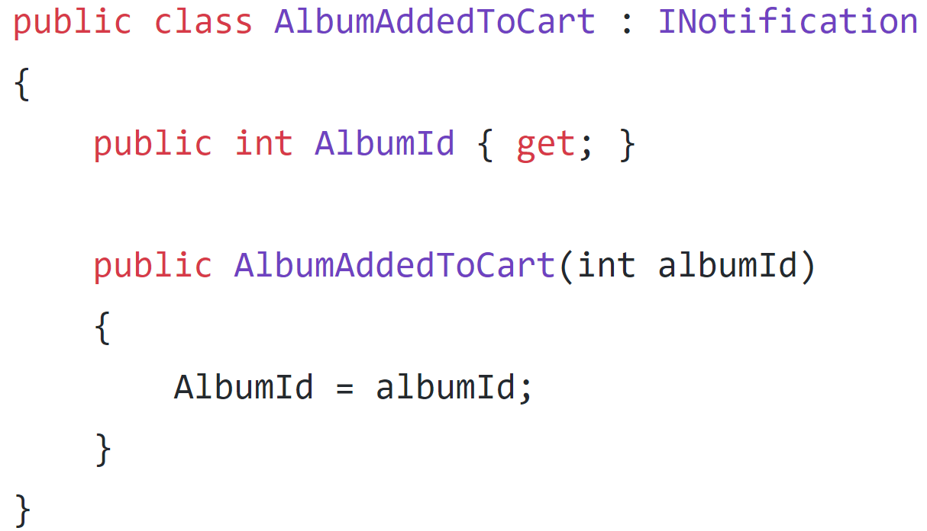
Notes:
TODO: Add Diagrams

Slide 48
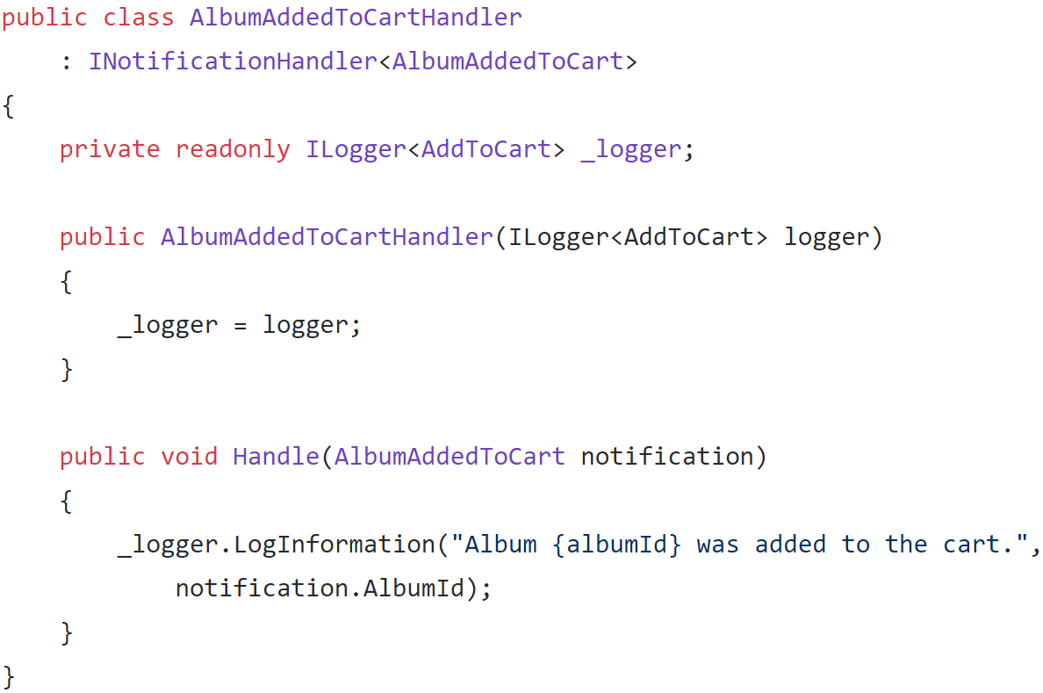
Notes:
TODO: Add Diagrams

Slide 49
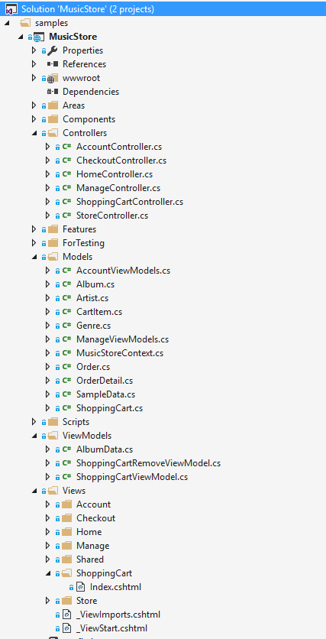
Organize By Layer
Controllers/ShoppingCartController.cs
ViewModels/ShoppingCartViewModel.cs
Models/ShoppingCart.cs
Views/ShopingCart/Index.cshtml

Slide 50
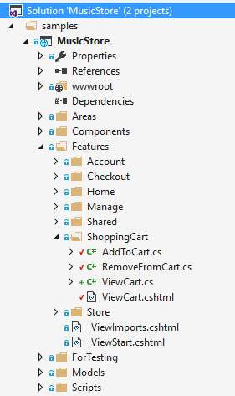
Organize By Feature
Features
ShoppingCart
AddToCart.cs RemoveFromCart.cs ViewCart.cs ViewCart.cshtml
Models
ShoppingCart.cs
Album.cs
CartItem.cs

Slide 51
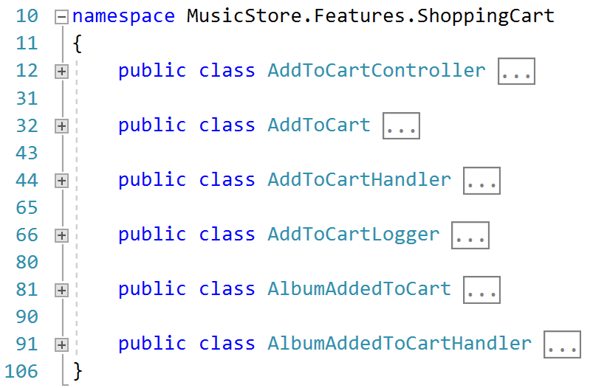

Slide 52
Organize By Layer
ASP.NET MVC
Authorization
Validation
Data Access
Model
Database
Notes:
Time = 42

Slide 53
Organize By Feature
Feature
Feature
Feature
Feature
Feature
Model
Database
Notes:
Time = 42

Slide 54
Single Feature
Controller
Authorization
Validation
Execution
Model
Database
Notes:
Time = 42

Slide 55
Single Feature
ASP.NET MVC
Authorization
Fluent Validation
Entity Framework
Model
Database
Notes:
Time = 42

Slide 56
Single Feature
Nancy
Authorization
Validation
Dapper
Model
Database
Notes:
Time = 42

Slide 57
Success!
Segregate our code from I/O
MediatR between integration boundaries
Feature Slices not Layers

Slide 58
Trade-Offs & Notes
Runtime Exceptions
Tests
Analyzer
DI Container & Registrations
Tests

Slide 59
Enabler
Async, Task Queues, Pub/Sub
Multiple Data Model/Stores
Dependencies per Command/Query

Slide 60
That’s it…
Thanks!
Derek Comartin
@codeopinion
codeopinion.com

